Slide 1

“Python is a high-level, versatile programming language widely used for data analysis, automation, web development, and machine learning. Its simplicity and extensive libraries like Pandas, NumPy, and Matplotlib make it ideal for analyzing data and creating insightful visualizations.”
Python introduction

Slide 2
Python project .1 problem .1 Sales Performance Analysis by City This code calculates the total sales for each city and displays them in descending order. Problem .2 Profit Performance by Product Category This code calculates the total profit for each category and displays them from highest to lowest.

Slide 3
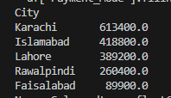

Sales Performance Analysis by City This code calculates the total sales for each city and displays them in descending order.
Profit Performance by Product Category
“This code calculates the total profit for each category and displays them from highest to lowest.

Slide 4
Python project .2
Problem .1
Payment Method Frequency
It counts how many times each payment method appears.
Problem .2
Order Status Distribution
This line prints the count of orders for each status (Completed, Pending, Cancelled)
Problem .3
Top Customer by Total Sales
the name at the top represents the customer with the highest total sales.

Slide 5
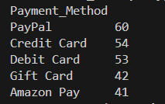


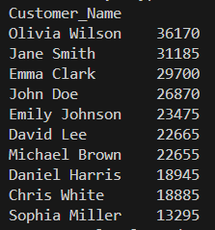
Payment Method Frequency It counts how many times each payment method appears.
Order Status Distribution
This line prints the count of orders for each status (Completed, Pending, Cancelled).
.
Top Customer by Total Sales
the name at the top represents the customer with the highest total sales.
.

